Slide 1
Picklists
In Salesforce, picklists are a type of field that provide users with a predefined list of options to choose from. They help standardize data entry by limiting the choices available for a field, ensuring consistency and preventing errors from free-form text entry.
There are two types of picklists in Salesforce:
Standard Picklists: Predefined by Salesforce and used in objects like Lead, Contact, or Opportunity. These are often used for fields like "Lead Status" or "Opportunity Stage.“
Custom Picklists: Created by users or administrators to define specific values for custom objects or additional fields in standard objects.
Picklists can be:
Single-select:
Multi-select
Global Picklists:
Used for sharing a single list of values across many custom picklist fields.
It is a restricted picklist. The global picklist values cannot be edited on custom picklist fields.
To change the values, the global picklist should be edited

Slide 2
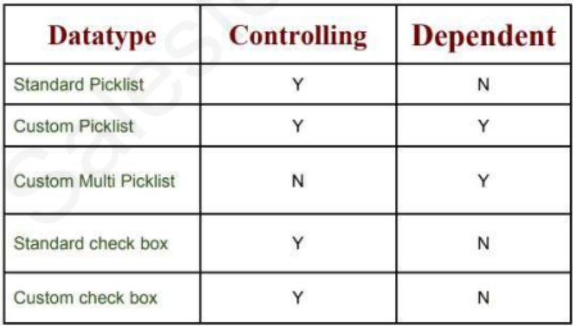
Field Dependency
These are filters that allow us to change the content of a picklist based on the value of another field checkbox/picklist
Controlling Field:
The value of this field controls the value of the dependent field
Dependent Field:
The value of this field depends on the value of the controlling field
Create Global Picklist
Demo
Create Picklists
Create Field Dependency

